Slide 1
Green University of Bangladesh
Department of Computer Science & Engineering
Subject: algorithms
Course Code: CSE-205
Presentation on Algorithm
Submitted To:
Name : Jargis Ahmed
Designation : Lecturer
Department : CSE
Green University of Bangladesh
Submitted by :
Name : Md. Nur A Neouse
ID :193002093
Batch no : 193
Section : Dc

Slide 2
Content
What is Algorithm ?
What is Algorithm Design ?
How to Design an Algorithm ?
Greedy Algorithms
Divide and Conquer
Dynamic Programming
Importance of Algorithm Design
Conclusion

Slide 3
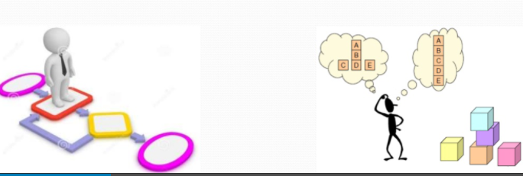
What is algorithm ?
An Algorithm is a Step by Step solution of a specific mathematical or computer related problem.

Slide 4
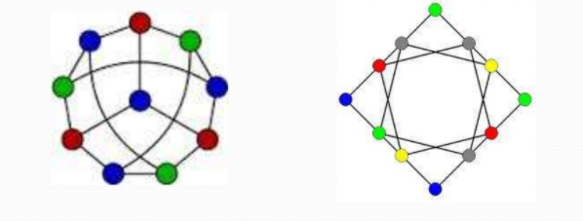
What is Algorithm-Design ?
Algorithm design is a specific method to create a mathematical process in solving problems.

Slide 5
How to design algorithm ?
There are four famous techniques of Algorithm design :
Greedy algorithm
Divide and Conquer
Dynamic programming
Back Tracking

Slide 6
Greedy Algorithms
An algorithm which always takes the best immediate or local solution while finding an answer.
Example:
I) Greedy algorithm for the Knapsack problem
ii) Minimal Spanning tree

Slide 7
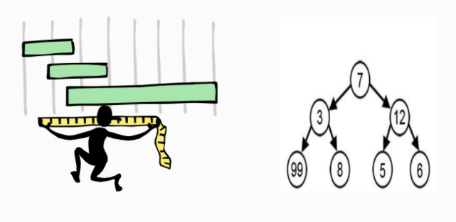
Image of greedy algorithm

Slide 8
Divide and Conquer
Break the problems into smaller sub-problems
Solve each of the sub-problems
Example:
I) Binary search in a sorted array (recursion)
ii) Quick sort algorithm (recursion)

Slide 9
Dynamic Programming
Dynamic programming is typically used to solve an optimization problem .
Examples:
Fibonacci numbers computed by iteration. Warshall ’s algorithm implemented by iterations.

Slide 10
Importance of algorithm design
It is used to store and access large quantities of data efficiently.
It is used to solve complex computational problems and to design of good programs
It is important to justify an algorithm correctness mathematically

Slide 11
Conclusion
At last it may said that , the so called program name Algorithm – design is one of the most enforceable solution program that can be used to solve any complicated , complex , and hard program.

Slide 12
Thank you

